Slide 1

Data Driven Education
Discussion Forum Subteam
Presentation 1 - 2/16/2022
Notes:
Pratik

Slide 2


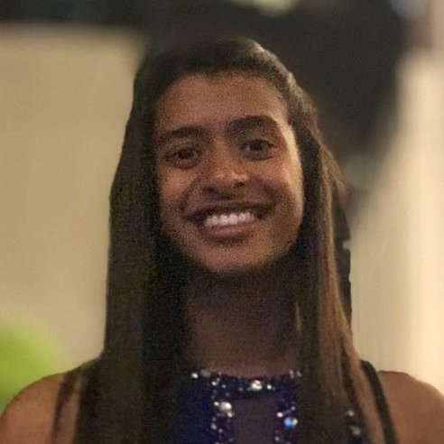
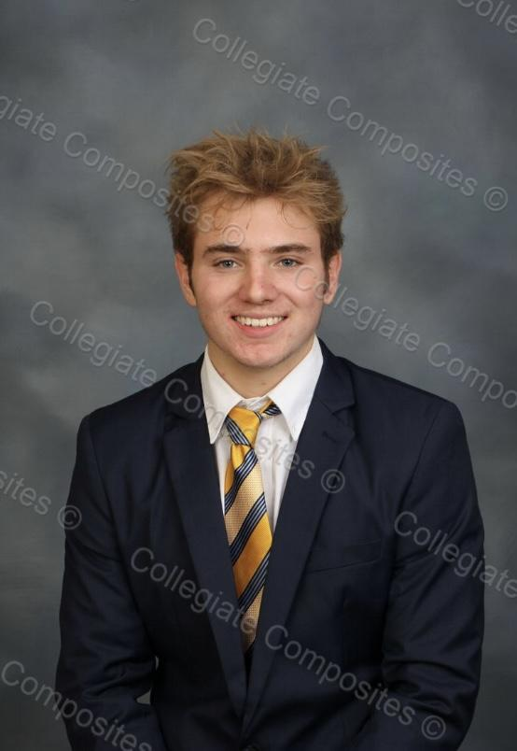

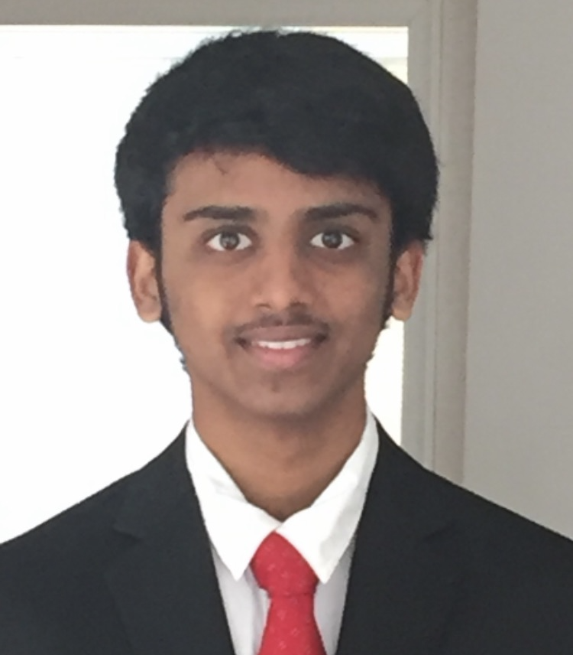


Team Members
Malav Patel
Data Scientist
Hyun Soo Kim
Back-end
Developer
Nidhi Pai
Data Scientist
Daniel Schall
Education Researcher
Aanya Khandelwal
Back-end
Developer
Gautam Sugasi
Back-end
Developer
Jisan Park
Data Scientist
Pratik Agarwal
Project Manager
Notes:
All

Slide 3


Introduction
Discussion forums
  Online formats - primary source of interaction
Student interaction
  Cognitive presence
  Social presence
Activity on forums indicative of student engagement and interest
Goal: Creating a web application to help instructors save time on managing forums and increase cognitive engagement in their courses
Notes:
Pratik
Discussion forums are the primary source of class interaction in an online asynchronous course. The activity on these forums can be used as an indicator for assessing students’ engagement and understanding in the course. A popular framework in this context is the community of inquiry framework. It gives us a way to study how student learning takes place in online and blended environments. As shown in the diagram there are 3 components, cognitive presence, social presence and teaching presence.We’re focusing on the first two as of now. The ultimate long term goal is to have a web-based application to be used by professors, that gives them insights in real-time which can be used to improve the cognitive engagement levels in their courses and reduce management overhead.

Slide 4
Recap of Fall 2021
Category | Accomplished | Next Goals
Web Dev | Working dashboard on real data (sentiment) | Pilot testing with real users (instructors) Integration with Piazza/Ed
UX Research | Identified few key features of importance to instructors | Create relevant metrics from forums data Pilot study on a real course
Data Science | Sentiment scoring and cognitive presence model on Piazza+EdX Analysis of top contributors and correlation with grades | Use cognitive presence to inform metrics of relevance Identify highly connected and most contributing students
Learnings and Challenges as a Project Manager:
Important to coordinate the team as a whole, and scheduling of project tasks
Set expectations clearly at the start of semester for the team and each individual
Quicker iterations and faster feedback loops - focus on quick launch
Notes:
Pratik
In the previous semester, web-dev team was able to integrate the web-app with the Data Science team’s sentiment analysis model getting the first version of our dashboard working on real Piazza data. In terms of UX research, we were able to collect a few survey results and couple interviews with instructors to help prioritize metrics for the dashboard. The data science team was able to build 2 models, one for sentiment and the other for cognitive presence. As a project manager, there are a few aspects I’d like to improve on based on reflections from previous semester. Mainly setting clear measurable goals at the start rather than in the middle, quicker feedback loops involving multiple interactions with target users, and better scheduling of tasks for each individual to minimize any bottlenecks in execution.

Slide 5

Focus for this semester
Development
  Deploy the web-app and test inside the Piazza sandbox environment
  Shorter feedback loops, try backtracking from goals to set individual deliverables and milestones
Research
  Metacognitive analysis on student posts in forums
  UX Research by connecting with instructor teams
Project Management
  Effective use of trello and other tools + improving documentation for the project
Notes:
Pratik
Our focus for this sem will be on pilot testing the web-app inside a Piazza sandbox environment, extracting the relevant metrics from forums data using the models developed by the Data Science team, and deepening our analysis on social presence and metacognition which will be elaborated by Daniel. We will continue using the Agile approach and Trello board that we’ve been using for the past few semesters for Project Management. However, there is significant scope for improving the project documentation and to use trello and other tools more effectively, which will also be explored this semester. Over to the Data Science Team.

Slide 6
Data Science

Slide 7
Research Goal
Based on the community of inquiry framework, what are some key factors in discussion forum activities influencing student engagement and performance in an asynchronous online classroom?
How can we design a web app that can provide actionable insights to the instructor in order to increase engagement and performance?
Notes:
Jisan
cognitive presence / metacognition presence
actionable insights: visualized graphics data
eg. a distribution of question by topics and average sentiment score of students.

Slide 8
Data Science Big Picture
Data available
  Focusing on Piazza data from Dr. Thad Starner
  1493 posts, coded for cognitive presence and working on Topic Modeling
Cognitive Presence
Sentiment Analysis
Data Science
Topic Modeling
Metacognition
Notes:
Jisan
multiple projects in data science
from last semesters, continuing work on cognitive presence and sentiment analysis
new research topics are topic modeling and metacognition

Slide 9
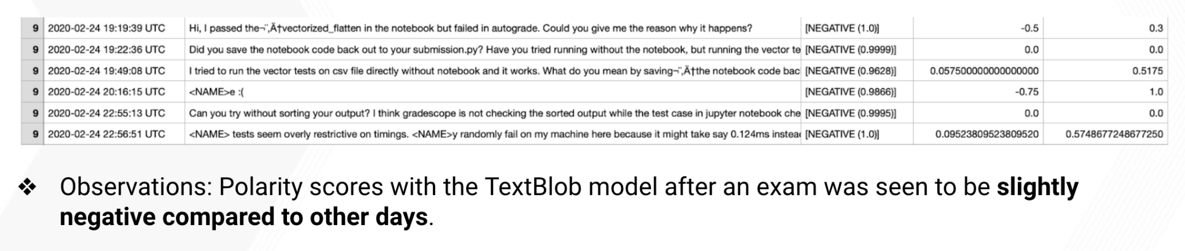
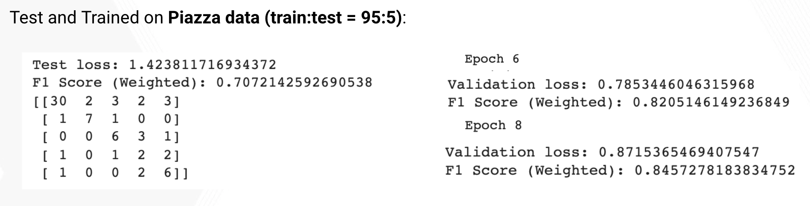
Sentiment Analysis and Cognitive Presence

Slide 10
Meeting with TA
It’s not quite useful to further analyze sentiments of the students in a well-established online course.
The study on cognitive presence analysis can be used to see if the questions need to be resolved or not after posting a follow-up.
Other Concerns:
  If we could reply to unresolved posts using similar posts from prev. semester.
  Duplicate posts: Good with smaller classes, but hard to scale up.
  Need a functionality to assign TAs to unresolved posts.

Slide 11
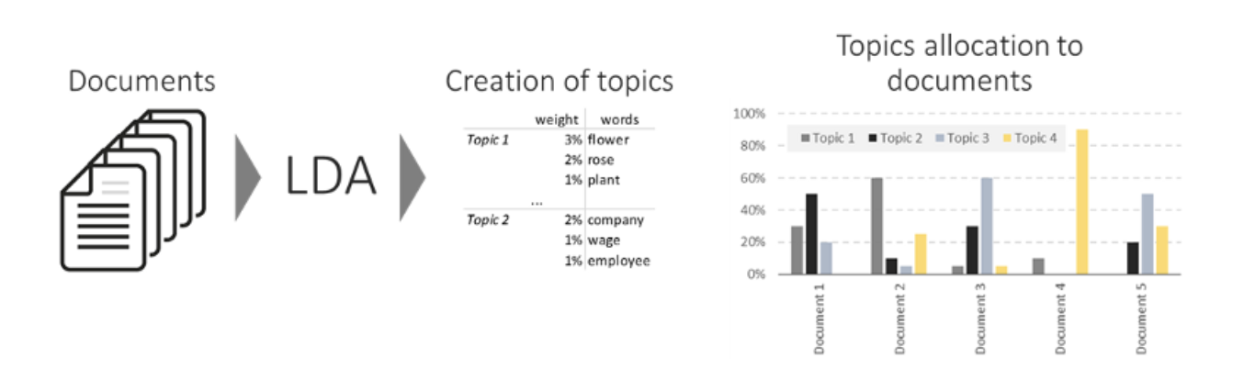
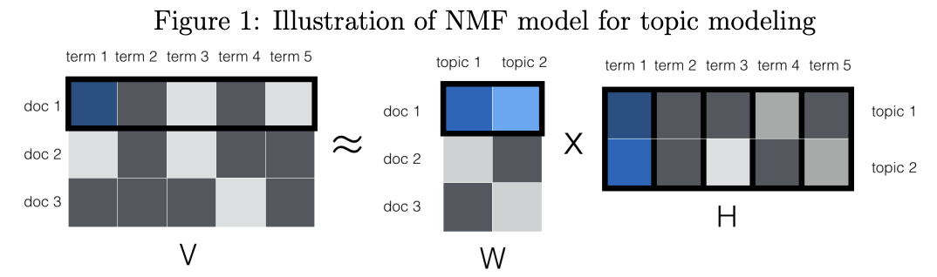
Topic Modeling
A type of statistics modeling to discover the abstract topics by text-mining and analyzing each documents.
Latent Dirichlet Allocation
  Topic Distribution in docs
  Weight of words in topics
Non-negative Matrix Factorization
  W doc by topic
  H topic by words
Notes:
Malav

Slide 12
Goals for this semester (Metacognition)
Metacognition: awareness and understanding of one's own thought processes.
  We hope to evaluate the possibility of integrating a metacognitive presence detection algorithm into our sentiment analysis software to determine which forms of types of discussion post assignments lead to higher-level metacognitive thinking.
Classifying EdX and Piazza data belonging to a particular topic.
Clustering repeated and similar questions from the cumulative semester to help to reduce the questions volume.
Notes:
Daniel / Jisan

Slide 13
UX Research

Slide 14
User Surveys & Interviews
Research Question: What metrics on a dashboard are useful to instructors in order to improve student engagement & performance and/or reduce workload for instructors?
Goals:
Collect ideas & insights from users on utility of metrics.
Find the intersection between valuable metrics and feasible metrics.
Pilot test prototypes with users.
Notes:
Nidhi

Slide 15
User Surveys & Interviews - Previous Work
Conducted interviews with TAs & instructors from OMS classes
  Dr. Joyner, James Lohse, Vaibhav Bhosale
Gave out survey for feedback on metrics
Reported on:
  Metrics to include on dashboard
  Problems with using discussion forums
  Research topics for further investigation
Notes:
Nidhi
research topics like patterns over multiple semesters, social network analysis

Slide 16
User Surveys & Interviews - Semester Goals
  Focus on feasible + useful metrics
  Work with web dev team and data science team
  Iteratively request feedback on metrics developed
  Interview TA’s with prototypes of the dashboard as we go
Notes:
Nidhi
want to focus on feasability
for example, summarizing posts or grouping posts that have the same question might be a little difficult

Slide 17
Web Development

Slide 18
Front-End Web Development
Current Progress:
  High-fidelity mockups using Figma (design software)
    Allows us to test different information layouts and experiment with different ideas before deciding on a final one to code
  Flask model
    Has many libraries that handle data storage and manipulation, serving content to the web-app, and connects well with the SQLite3 database
Next Steps:
  Help backend team with connecting Piazza to database
  Possibly use React on the front end instead of Flask
Notes:
Gautam

Slide 19




Web-App Flow
SQLite3 database of student discussion posts, as well as the sentiment, polarity, subjectivity of the posts
Fetching and processing data from database (forum_database.py)
Creating graphs using matplotlib and saving them as images
Serving images and other webpage elements on web-app using Flask
Notes:
Gautam

Slide 20
Back-End Web Development
Research Question/Goal: To integrate real-time Piazza data into the pipeline
Set up a Sandbox Piazza
  Access to Piazza student statistics
  Available in .csv format
Setting up Piazza API to access
  Access to data through Python
  Integrate into database
Coordinating with Data Science team to understand metrics
  Look through Piazza API for metrics that are readily available
  Isolate those not available
Setting up meeting with PARQR team to learn about student comment extraction
Notes:
Aanya

Slide 21



Workflow Diagram
Built pipeline from database to front-end
Integrate into a real time prototype
Last semester
End goal for this semester
Analysis from Data Science team
Use our pilot app to support professors
Here right now
Future goal
Notes:
Harriet

Slide 22
Conclusion
Project Roadmap
  Deployment of web-app and testing in Piazza sandbox environment and user feedback from instructor team
Model Development
  Topic Modeling to cluster similar posts/questions together
Education Research
  Metacognition in online discussion forums (EdX, Piazza etc) and effect on learning outcomes
Notes:
Pratik
To conclude, the next steps in the roadmap is getting the web-app deployed, use topic modeling approach to cluster similar posts which will help create an FAQ list in advance and help reduce overhead by reducing volume of repetitive questions, and get quick feedback from instructors. In education research, our focus will be on understanding metacognition and its manifestation in online discussion forums. Thank you for your time.

Slide 23
Citations
Garrison, D. R., Anderson, T., & Archer, W. (1999). Critical Inquiry in a Text-Based Environment: Computer Conferencing in Higher Education. The Internet and Higher Education, 2(2–3), 87–105. https://doi.org/10.1016/S1096-7516(00)00016-6
Garrison, D. R., Anderson, T., & Archer, W. (2001). Critical thinking, cognitive presence, and computer conferencing in distance education. American Journal of Distance Education, 15(1), 7–23. https://doi.org/10.1080/08923640109527071
Devlin, J., Chang, M. W., Lee, K., & Toutanova, K. (2018). Bert: Pre-training of deep bidirectional transformers for language understanding. arXiv preprint arXiv:1810.04805.
Medhat, Walaa, Hassan, Ahmed, Hoda, Korashy (2014). Sentiment analysis algorithms and applications: A survey. Ain Sham Engineering Journals. https://doi.org/10.1016/j.asej.2014.04.011
MacMillan, Kelsey, and James D. Wilson. Topic Supervised Non-Negative Matrix Factorization, Arxiv, 4 July 2017, https://arxiv.org/pdf/1706.05084.pdf.
Beri, Aditya. “Latent Dirichlet Allocation.” Latent Dirichlet Allocation, CodeChef-VIT, 27 Jan. 2021, https://medium.com/codechef-vit/latent-dirichlet-allocation-812bb8099518.

Slide 24
Questions?

Slide 25
Data Science Goals
First, focus on
Timeframe
Notes:
Malav

Slide 26
Approach used in previous semester
The classic WMD example from [5]

Slide 27
Challenges encountered

Slide 28
Goals for this semester (Data Science)
Sentiment Analysis of Piazza Data

Slide 29

Community of Inquiry
“a group of individuals who collaboratively engage in purposeful critical discourse and reflection to construct personal meaning and confirm mutual understanding”
Elements of an Educational Experience (Garrison et al., 1999)

